Slide 1
Predicting Home Value
G.A. Data Science
Final Project Michael Wong

Slide 2
Problem Statement
Where to buy rental property?
Looking for stable, or ideally, rising home value
But how do we predict that?
What factors tend to influence home value?
Developed a data-driven approach to determine the factors that affect property prices, and use this understanding to decide where to invest.

Slide 3
The Data
Annual American Community Survey (ACS)
2010-2015 survey results
Hypothesis: use demographic information to predict home value
Household income
Race
Educational attainment
Employment status
Brooklyn, 2 family and 3-4 family homes

Slide 4
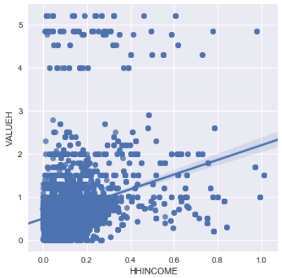
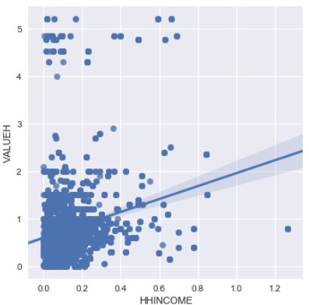
VALUEH vs HHINCOME
2 Family
3-4 Family

Slide 5
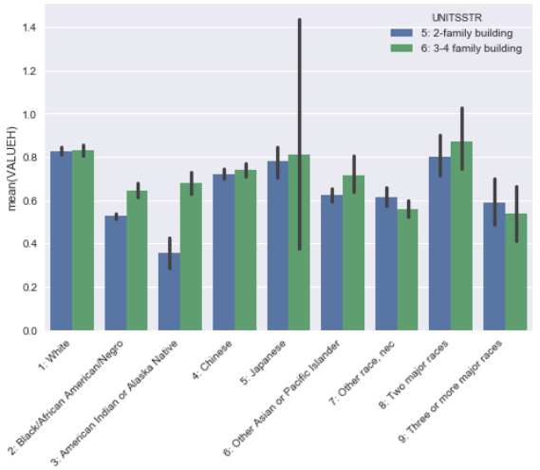
Race

Slide 6
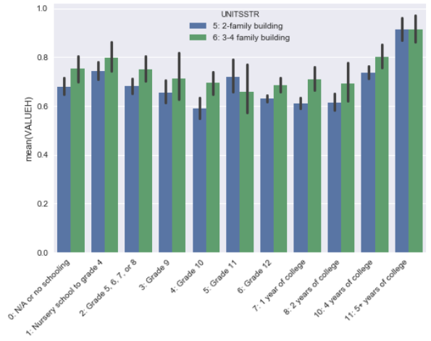
Educational Attainment

Slide 7
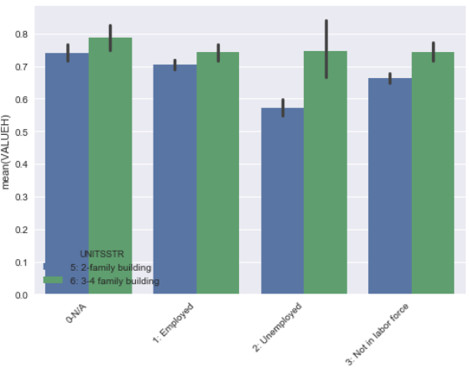
Employment Status

Slide 8
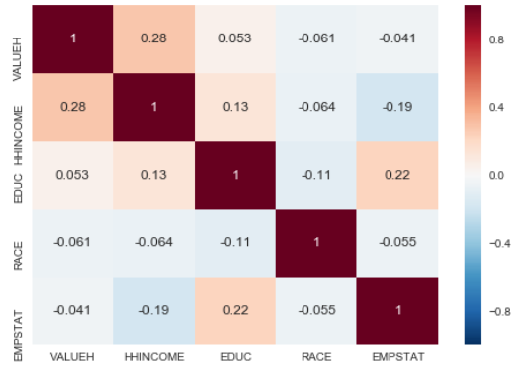
Correlation

Slide 9
The Model Approach
Linear Regression
Statsmodel (Adjusted R²)
SKLearn with Cross Validation (MSE)
Regularization with Ridge method (MSE),
with Grid Search for Alpha
Decision Tree with Cross Validation
Random Forest with Cross Validation

Slide 10
Results
Linear Regression: Statsmodel
2 Family, ~15,000 households
P-values indicated significant relationships for all variables except for:
Race: Japanese, Two Major Races
Education: Elementary to Grade 10, 1 or 2 years of college
Adj R2 = 0.14
3-4 family - ~6,000 households
P-values indicated significant relationships for
Race: Black, or Other (2 categories)
Education: 5+ years of college
Employment: only Employed matters
Adj R2=0.07

Slide 11
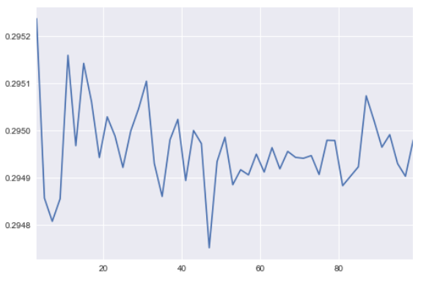
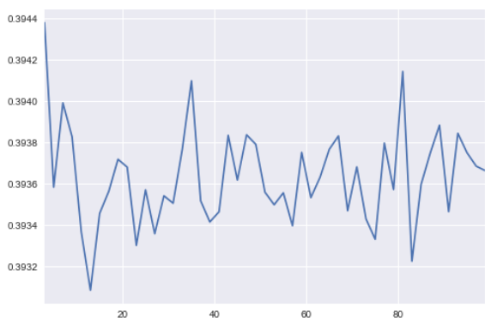
Results
SKLearn with Cross Validation (MSE), 10 folds
2 Family, mean MSE=0.30, best is 0.25
3-4 family, mean MSE=0.39, best is 0.31
2 Family
3-4 Family

Slide 12
Results
Regularization with Ridge method, Grid Search
2 Family: Best score (MSE) = 0.30 with Alpha = 1.0
3-4 family Best score (MSE) = 0.40 with Alpha = 0.1
Decision Tree with Cross Validation
2 Family: MSE = 0.38
3-4 family: MSE = 0.52

Slide 13
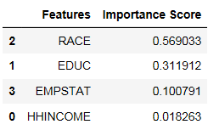
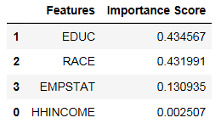
Results
Random Forest
2 Family
3-4 Family

Slide 14
Conclusion
Race, Educational Attainment, Employment Status and Household Income may influence the value of 2 and 3-4 family homes in Brooklyn
However, prediction of home values using these features on their own with the models presented would be insufficient as mean-squared-error is consistently high across the study

Slide 15
Next Steps
Research and include additional features from the ACS survey and other data sets to improve prediction scores
Research additional models that can be applied to better represent the relationships in this system

